Slide 1





NLP Project
Title: Resume Screening
Presented By:
Name – Nihar
Sapid – 500091867
Roll.No – R2142210525
Presented To:
Dr. Touseef Iqbal​
School of Computer Science

Slide 2



CONTENT
Introduction
Working and Flowchart
Area of Application
Dataset
Working Model
Result

Slide 3


INTRODUCTION
In today's competitive job market, manual resume screening is time-consuming and prone to biases.
This project helps to automate the process of analyzing resumes in PDF format using machine learning and NLP.
This project helps to predict the most suitable job profession of the candidate, by streamlining the recruitment, saving time and improving hiring process.

Slide 4
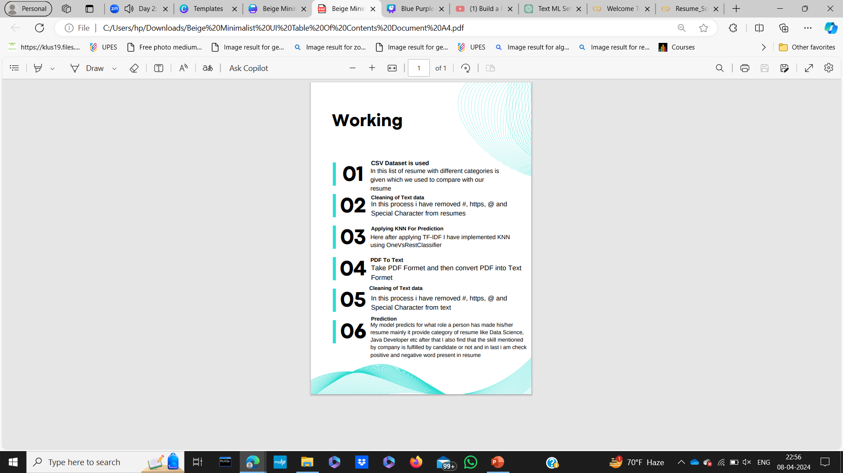
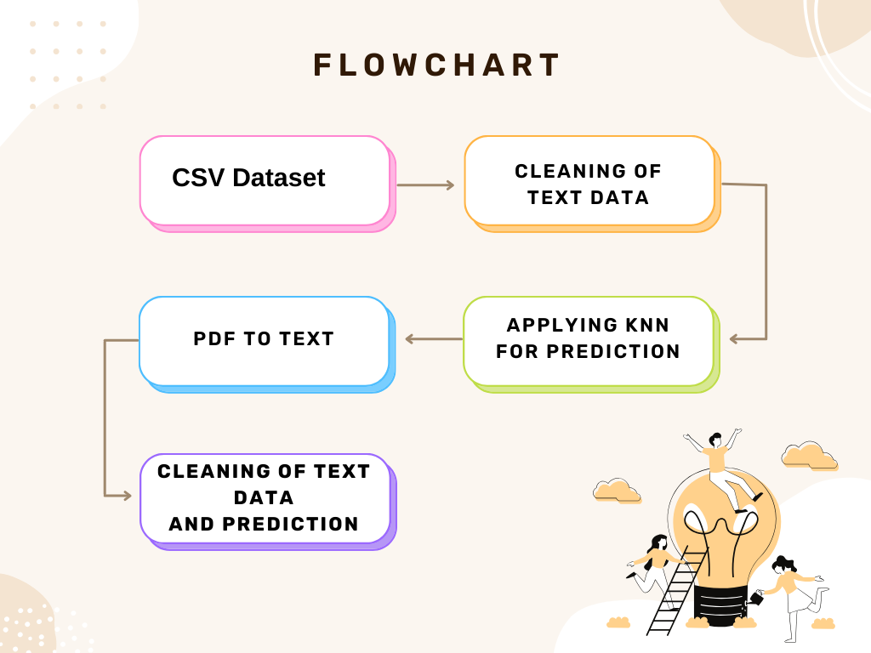

Slide 5
AREA OF APPLICATION
This resume analyzer has broad applications across the industrial sector:-
1. Recruitment and HR: Resume screening in HR departments can save time and improve candidate selection.
2. Education and Career Counseling: Guiding students and job seekers toward suitable career paths based on their skills and qualifications.
3. Corporate Training: By identifying the skills and career aspirations of the employee training opportunities can be set for him.

Slide 6
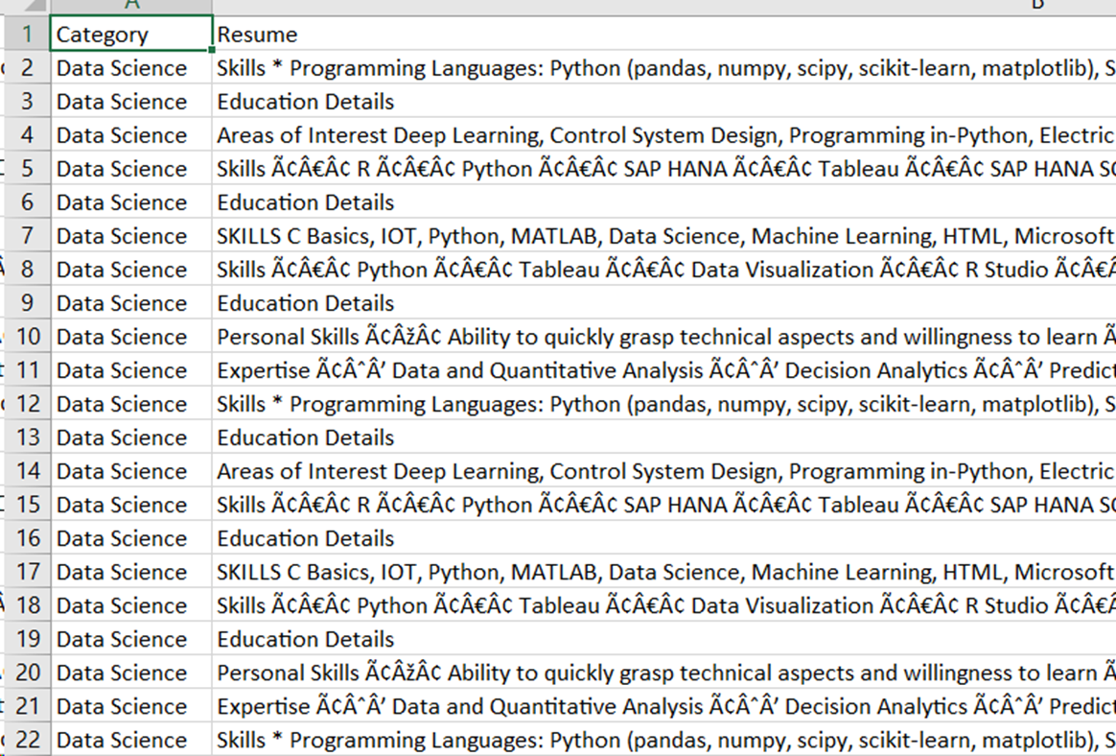
DATASET
The dataset used here consists of 25 Categories with Resumes.

Slide 7
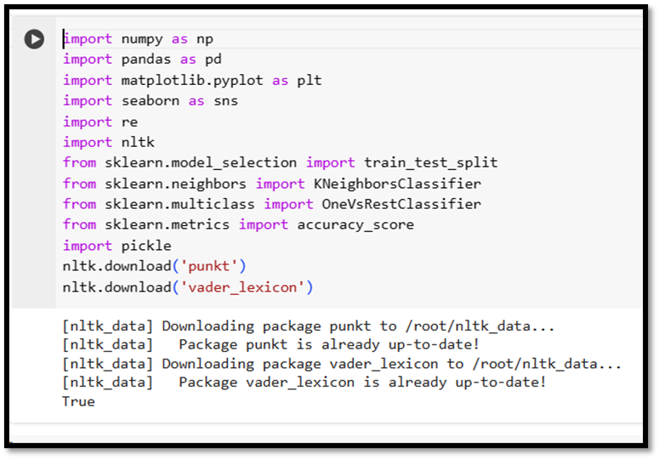
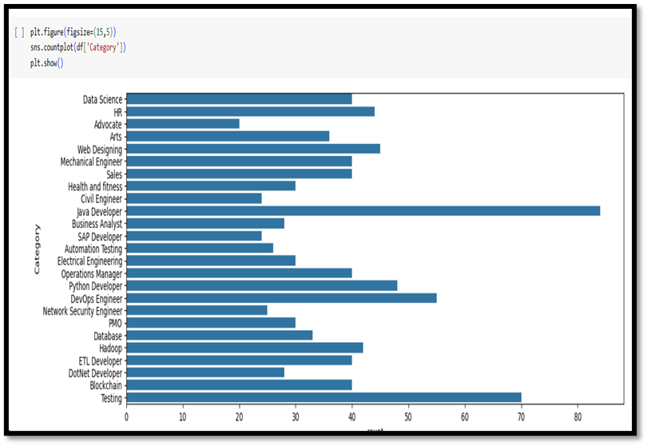
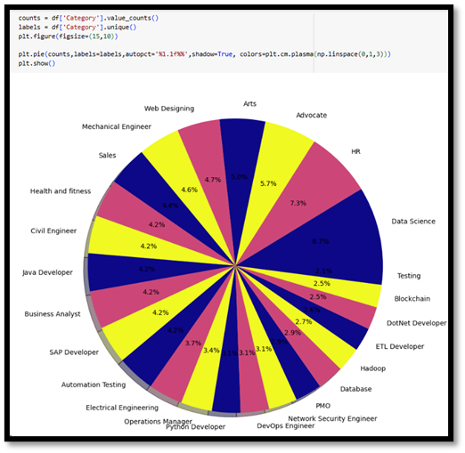
WORKING MODULE & ATTAINED DELIVERABLE

Slide 8
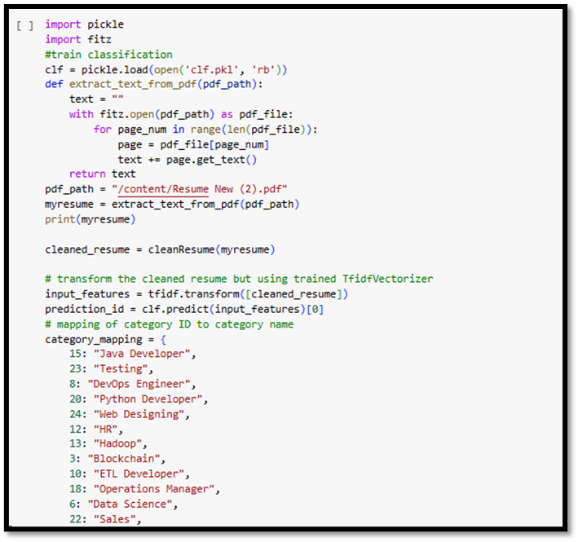

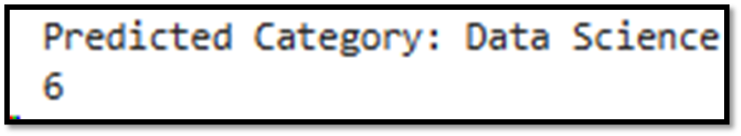
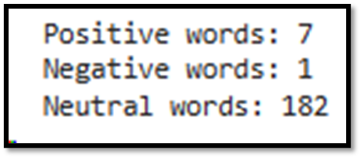

RESULT

Slide 9

Thank You

